Slide 1
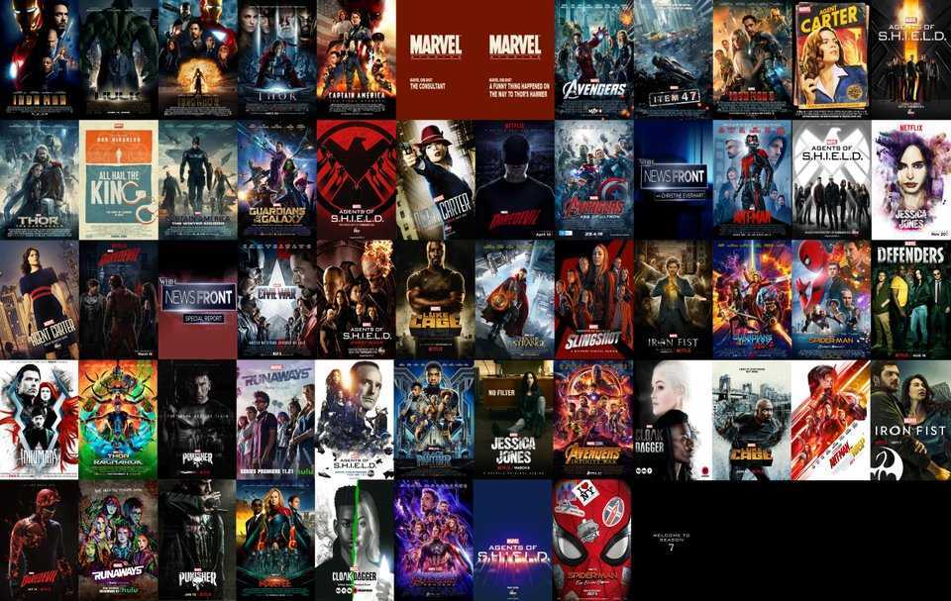
Posters Web App
By Hagai Kraus

Slide 2
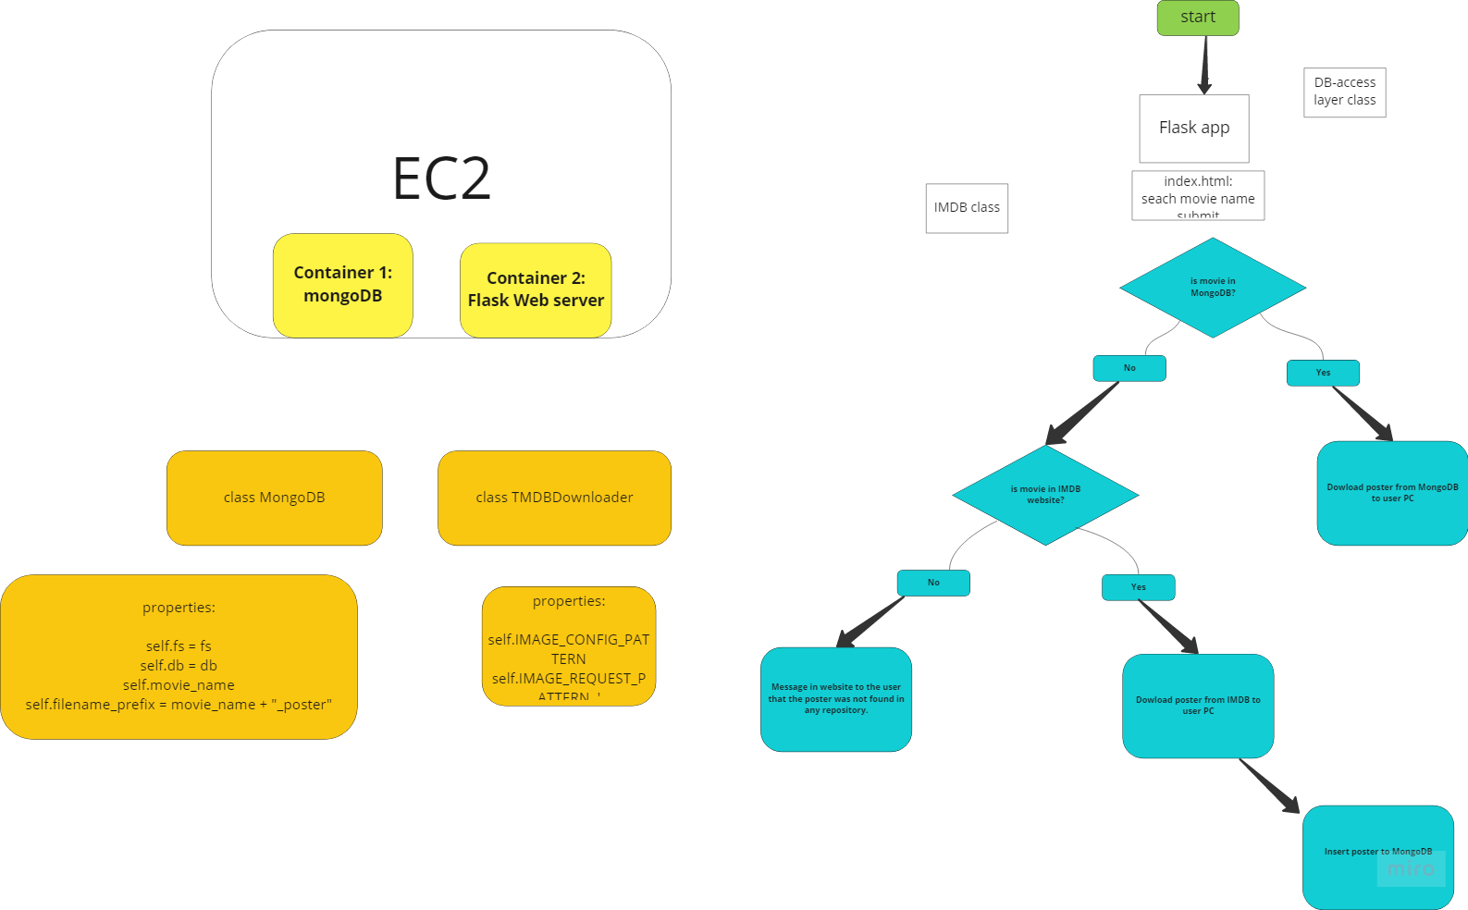
App Overview

Slide 3

Project Description:
This project uses a web browser to download a chosen movie poster,
the program first start looking at a designated MongoDB if the poster is not found there,
The software tries to download it from IMDB through API request using API key,
after downloading the poster from IMDB to the local computer the poster is inserted to MongoDB,
so the next time the very same poster will be requested it will be retrieved from MongoDB,
which will be faster.

Slide 4

Demonstration

Slide 5
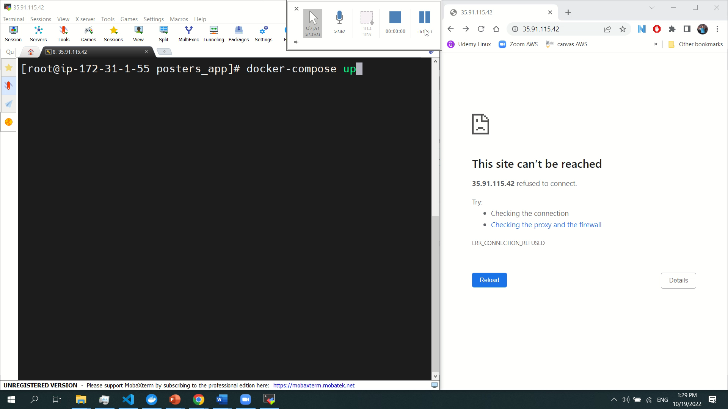
Demonstration 1 on EC2

Slide 6
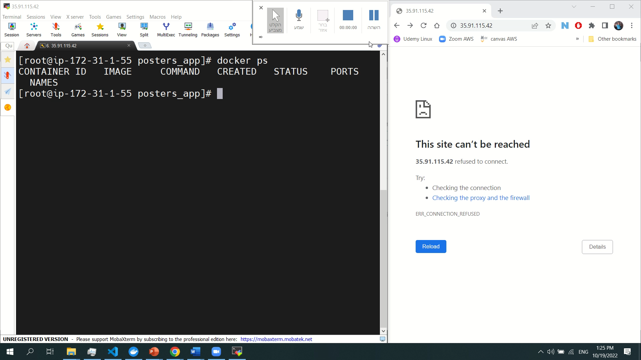
Demonstration 2 on EC2

Slide 7
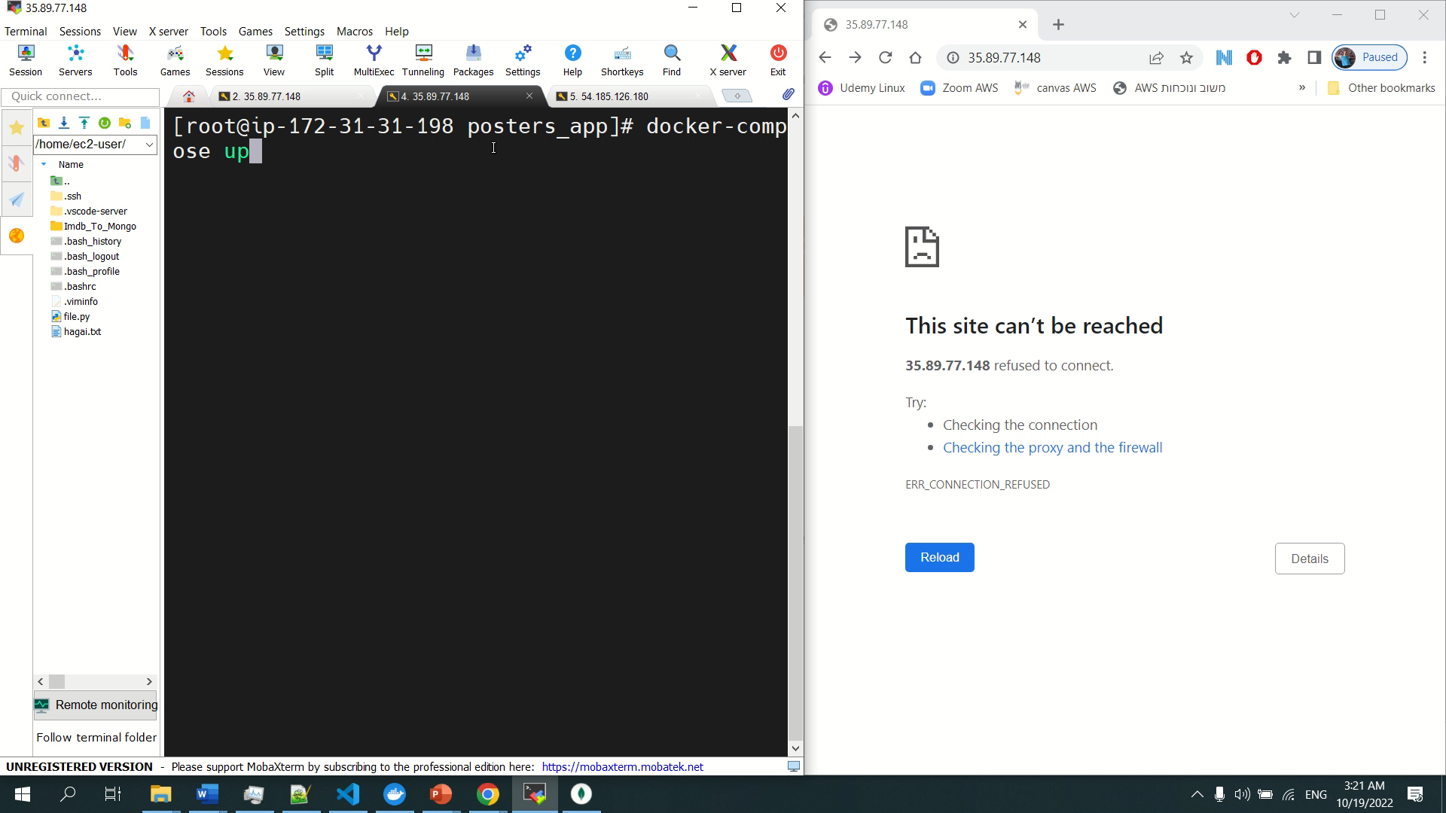
Demonstration Of MongoDB Memory Cache on EC2

Slide 8

Challenges
Accidently uploading the API KEY to Github
Facing new technologies: (Docker, Docker-compse, MongoDB)
Bugs

Slide 9

Work-flow:
I divided the projects to smaller tasks:
Make the app download a movie from IMDB to my local PC.
Put the poster into MongoDB
Make the app work through one Docker containers
Make the app work using docker-compose
etc..

Slide 10
If I Had More Time to Work On The Project
Write a script to automate the creation of the EC2 with the user data
Use best practices to transfer API-KEY to the Docker container
Improve Frontend design and UX.

Slide 11


